Slide 1
Home Credit Default Risk
Brian Beres, Justin Corlett, Zane Petras, Alex Russett

Slide 2

Agenda
Problem Overview
Data Overview
Critiques on Available Solutions
Our Solution
Final Thoughts

Slide 3
Problem Overview
Many people struggle to obtain loans because of:
Insufficient credit history
Non-existent credit history
These people are often taken advantage of by untrustworthy lenders
Goal is to predict repayment abilities for unbanked population

Slide 4
Data Overview
Application Test/Train csv files
Train; 122 columns
Test; 121 columns
Dependent Variable:
“Target”
Binary; Comprised of 0,1
Only present in the train csv file
Other csv files provided:
Bureau, credit card balance, previous application, etc.
Over 1 million rows

Slide 5
Critiques (Model 1)
Submission titled “First Model - Simple Logistic Regression”
Score: 0.56
Uses Logistic Regression instead of boosting model (XGBoost)
Has minimal pre-processing
Pros:
Runs quickly
Simple to understand

Slide 6
Critiques (Model 2)
Submission titled “Getting Rid of EXT_SOURCE Variables”
Score: 0.71
Bronze medal in competition
Strategy: Logistic regression and pre-processing
Used a series of if-else statements to adjust inputs
Significant improvement in score from just logistic regression
Issues
Could perform much worse on further data
Not the most efficient modelling technique
Hard to read

Slide 7
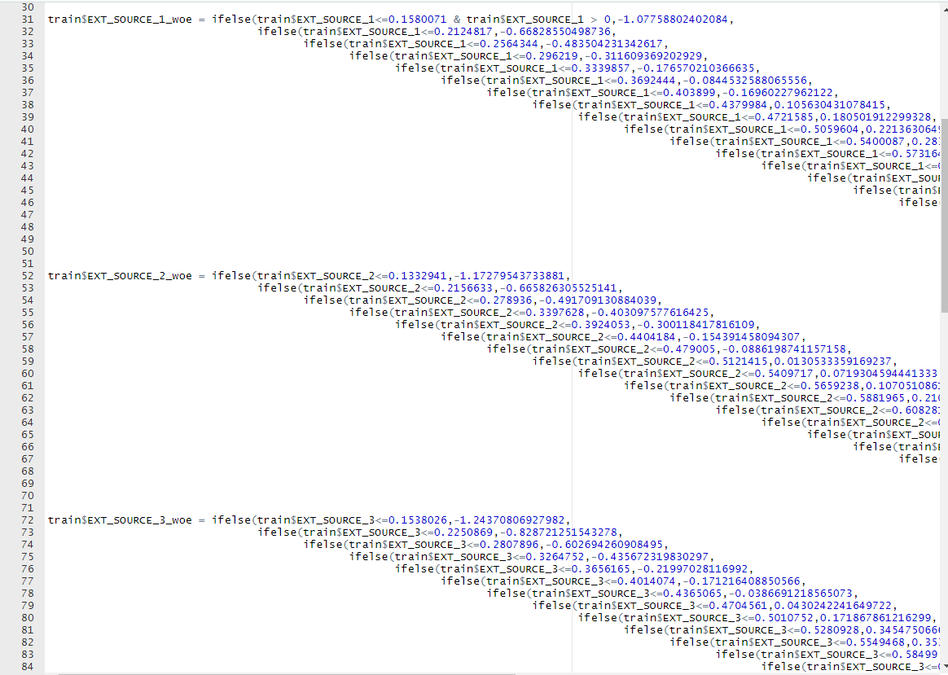
Critiques (Model 2)
Not easy to follow
Could prove difficult to recreate
Overfitting

Slide 8
Critiques (Model 3)
Submission titled “tidy_xgb_0_778.R”
Score: 0.782075
Gold medal in competition
Strategy: Pre-processing and gradient boosting
Extensive, but comprehensible preprocessing
Significant improvement in score from just logistic regression
Issues
Takes much longer than other models

Slide 9
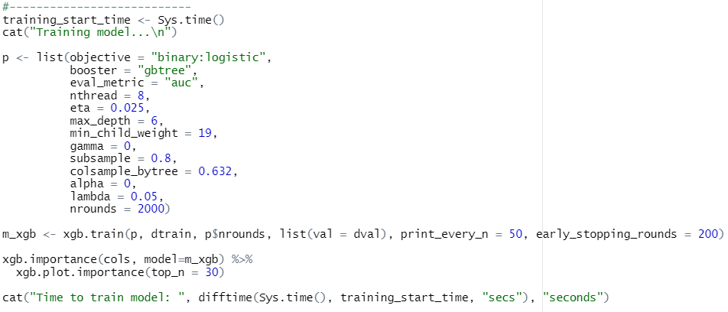
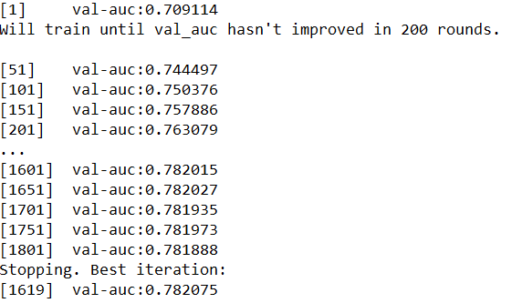
Critiques (Model 3)
Training process:
Took very long:
24.70s to load data
3.12mins for preprocessing
1.62s for data prep
10.05mins to train model
13.61mins in total
Sample output:

Slide 10
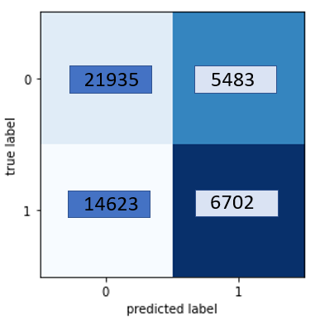
Our Solution
Using gradient boosted decision trees (XGBoost)
Modeled out data as “Categorical” as we dealt with a Classification Problem
Final Accuracy Rate of 72.5%

Slide 11
Final Thoughts
Better performance can be achieved utilizing complex feature engineering at the expense of computation time and risking overfitting
Faster models can be built at the expense of sacrificing validation accuracy
Gradient Boosting allows for moderate model simplicity and satisfactory performance on non-linear datasets

